Slide 1


AI Customer Analyzer (The Project AIMVCA)
An Artificial Intelligence System That Analyzes Customers Using Computer Vision
Project Executive: Dr. Yasas Jayaweera
Project Manager: Gunarakulan Gunaretnam (2208408)
Startup Manager: Sangeetha Thangavadivel (2135801)
Risk Manager: Haritha Thavarajah (2211320)
Schedule Manager: MathumithaArasakulasoorian (2211336)
Quality Manager: Delaxsan Raj Sathiyanesan (2211294)

Slide 2

CONTENTS
Introduction
Scope of Work
Features of the System
Technical Requirements
Benefits of the System
Conclusion

Slide 3

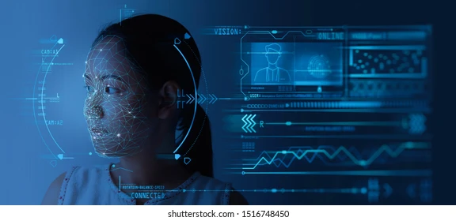
Introduction
The client DreamSpace Marketplace is looking to develop an AI customer analyzer system to explore their computer attributes such as number of customers visits their premises, gender and age ranges, emotions of customer when they enter and their race and etc.

Slide 4
Scope of the Project
The scope of this project includes the development of an AI customer analyzer system that uses computer vision and machine learning to perform customer analyzation.
Provide an effective way to explore customers.
Improve productivities via analyzing customers.
Provide customers needs in future,
Help organization to decide what goods will be sold.

Slide 5
Features of the Project
The scope of this project includes the development of an AI security bot that uses computer vision and machine learning to perform the following tasks:
Welcome visitors as they enter the premises.
Count the number of visitors.
Predict the age range, gender, and mood of visitors using computer vision and machine learning algorithms.
Provide reminders to visitors to wear a face mask if necessary.

Slide 6

Features of the Project
Visitor Counting:
01
03
Age, Gender, Mood and Race Prediction:
Mask Reminder:
UI-friendly Interface:
02
04
The system should accurately count the number of visitors entering.
The system should use computer vision and machine learning algorithms to predict the age range, gender, and mood of visitors.
The system should remind visitors to wear a mask if necessary.
The system should have a user-friendly interface that allows easy interaction with visitors.

Slide 7
Technical Requirements
The system should be developed using Python, computer vision, and machine learning libraries such as OpenCV and TensorFlow. MERN
The system should use deep learning algorithms such as convolutional neural networks (CNNs) for age, gender, and mood prediction.

Slide 8
Conclusion

